Slide 1
TOPIC:-
BCG MATRIX
Submitted To:- Shashwat Singhal
Submitted By:- Unnati Chaurasia

Slide 2
WHAT IS BCG MATRIX ?
The BCG Matrix (Boston Consulting Group Matrix) is a strategic management tool used by businesses to evaluate and manage their product portfolio or business units. It was developed by the Boston Consulting Group (BCG) in 1970 to help organizations decide how to allocate resources among different products based on their market performance.
The matrix compares products using two key factors:
Market Growth Rate – Indicates how fast the market is growing and the future potential of the product.
Relative Market Share – Measures the product's market position compared to its competitors.

Slide 3
FOUR QUADRANTS OF
BCG MATRIX
Stars: High market growth and high market share; require investment for future growth.
Cash Cows: High market share but low market growth; generate steady profits.
Question Marks: High market growth but low market share; need investment to grow.
Dogs: Low market growth and low market share; have limited profit potential.

Slide 4
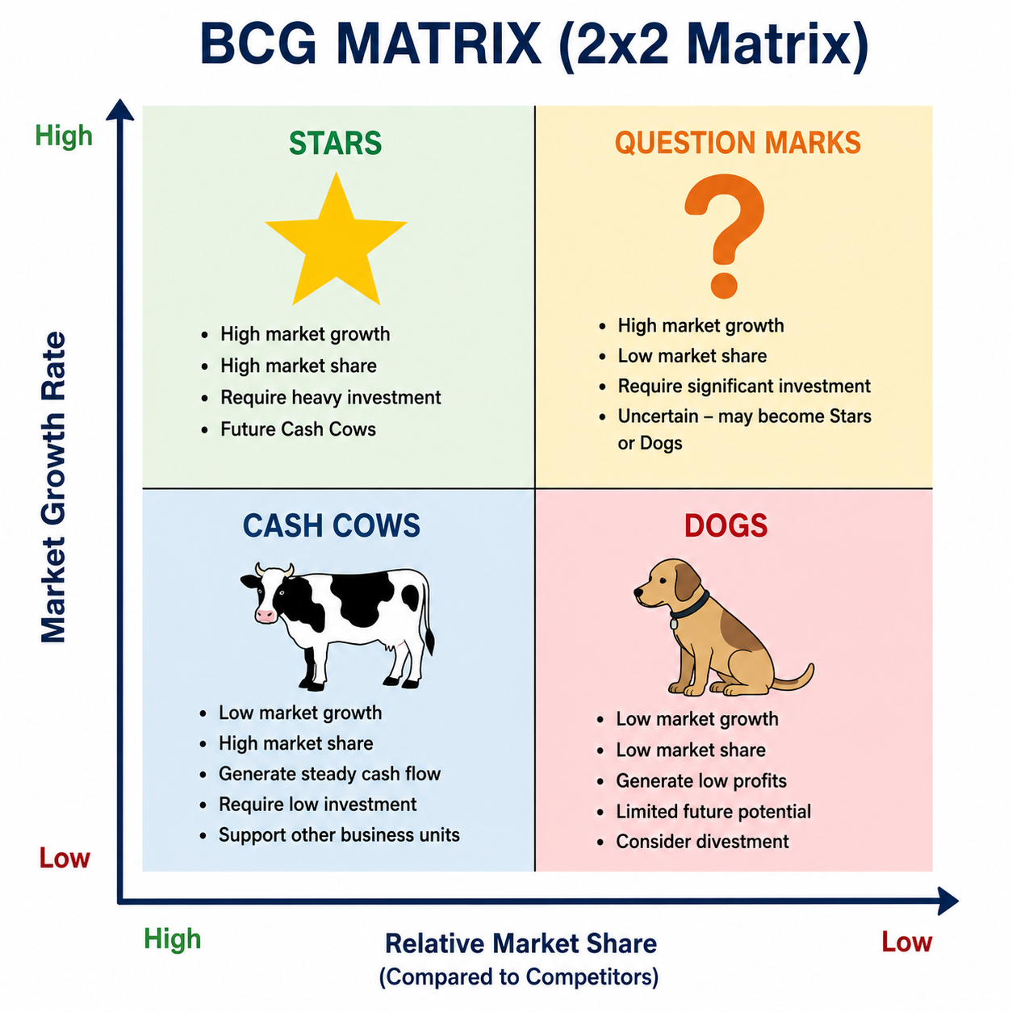

Slide 5
HOW BCG MATRIX WORKS ?
Identify all products or business units.
Measure the market growth rate.
Calculate the relative market share.
Place each product in the appropriate quadrant.
Develop strategies for each category.
Review and update the matrix regularly.

Slide 6
IMPORTANCE OF BCG MATRIX
Improves business planning.
Helps prioritize investments.
Reduces financial risk.
Increases profitability.
Supports product life-cycle management.
Strengthens competitive advantage.

Slide 7
OBJECTIVES OF BCG MATRIX
Analyse a company's product portfolio.
Allocate resources efficiently.
Identify profitable products.
Support investment decisions.
Improve long-term business growth.
Maintain a balanced product mix.

Slide 8
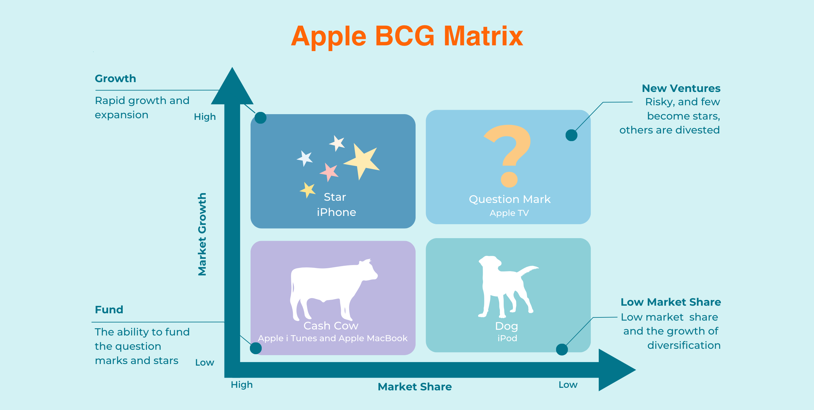
EXAMPLES OF BCG MATRIX
Examples
Apple
  Stars – iPhone
  Cash Cow – Mac
  Question Mark – Vision Pro (early stage)
  Dogs – Discontinued iPod
Coca-Cola
  Cash Cow – Coca-Cola Classic
  Question Mark – New beverage launches

Slide 9
DIFFERENCE BETWEEN THE
FOUR QUADRANTS
Stars | Cash Cows | Question Marks | Dogs
High Growth | Low Growth | High Growth | Low Growth
High Market Share | High Market Share | Low Market Share | Low Market Share
Need High Investment | Generate High Cash | High Risk | Low Profit
Future Cash Cows | Stable Income | Can Become Stars | Usually Discontinued

Slide 10
CONCLUSION
The BCG Matrix is a simple and effective strategic planning tool.
It helps companies evaluate their products based on market growth and market share.
Businesses can decide where to invest, maintain, or discontinue products.
Using the BCG Matrix improves resource allocation and profitability.
When combined with other strategic tools, it supports sustainable growth and long-term business success.

